Slide 1
Power Factor
Course: Introduction To Electrical Circuits Lab
Faculty: Abu Hena Md. Shatil
Section: H
Presented By:
Name: Nafinur Leo
Id: 20-42195-1

Slide 2
Outline:-
Introduction
Equation
Examples
Advantages and disadvantages
Power factor correction
Methods of power factor correction

Slide 3

Power factor is the ratio of true power and apparent power.
In resistive load power factor is unity.
In inductive load power factor is lagging.
In capacitive load power factor is leading.

Slide 4
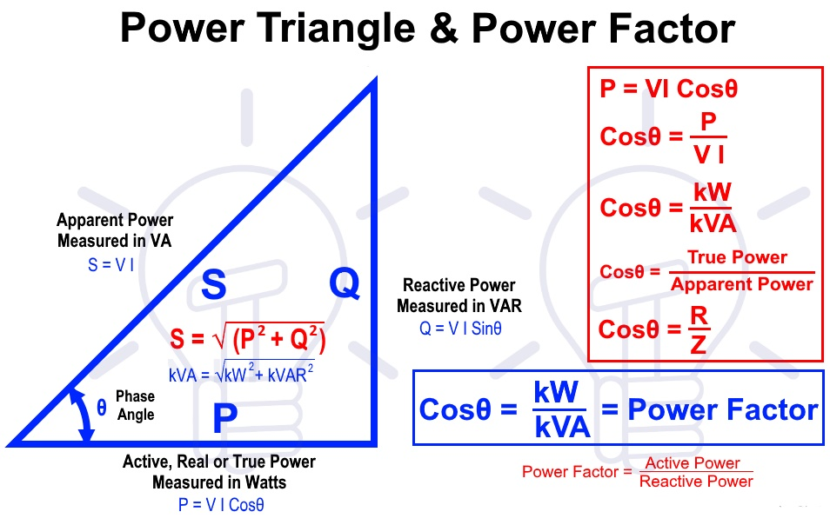
Equation:

Slide 5
Examples of loads in power factor:
No. | Load Type | PF
01 | Induction motor | 0.8
02 | Neon lamp | 0.4-0.5
03 | Induction heater | 0.85
04 | Are welding | 0.3-0.4
05 | Induction furnace | 0.6
06 | Fluorescent lamp | 0.6-0.8
07 | Resistance heater | 1.0

Slide 6
Advantages of power factor:
i) Reduce cost of copper
ii) Increase available power
iii) Reduce line losses
iv) Reduce conductor size
Disadvantages of power factor:
i) Large copper losses
ii) Poor voltage regulation
iii) Greater conductor size
iv) System efficiency decreases

Slide 7
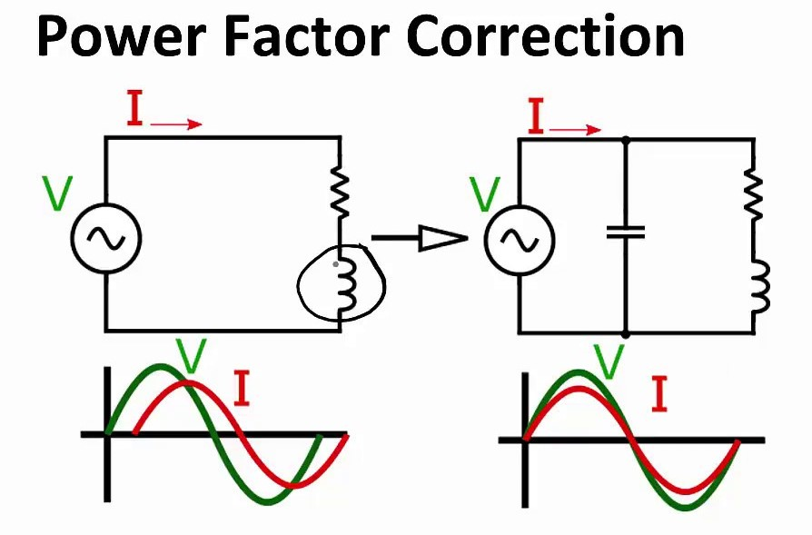
Power factor correction:
Power factor correction is the process of increasing the power factor to near unity without altering the original load.

Slide 8
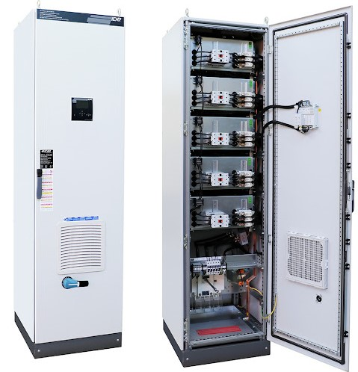
Methods of power factor correction:
i) Static capacitor
ii) Synchronous condenser
iii) Phase advancers

Slide 9
Static capacitor: Power factor can be improved by connecting static capacitor in parallel with the equipment operating at low power factor.
Advantages:
i) Smaller losses
ii) Require little maintenance
iii) Low initial cost
Disadvantages:
i) Short service life
ii) Easily damaged
iii) Repair is uneconomical

Slide 10
Synchronous condenser: It is usually used where a large quantity of corrective KVAR is required.
Advantages:
i) Improve power factor
ii) Can withstand over loads for short duration
Disadvantages:
i) Maintenance and operation cost high
ii) Lower efficiency
iii) Produce noise during operation

Slide 11
Phase advancers: It is a simple ac exciter and it can be mounted on the same shaft of the main motor.
Advantages:
i) Reduce lagging power factor KVAR
ii) Conveniently employed where synchronous condenser is not suitable
Disadvantages:
i) It is not economical for motors below 150 KW

Slide 12
Thank You

